Slide 1


Netflix Movie Data Analysis Project

Slide 2

QUESTIONS TO SOLVE BASED ON THE DATA
1.What are the top 5 most frequent gener on netflix?
2.Which genre has the lowest number of moves?
3.what are the top 10 most popular movies on netflix?

Slide 3
4.What is the oldest movie available on Netflix?
5.Which year received the highest average movies votes?
6.What is the correlation between popularity and number of votes?
7.What is the average number of movies release per year

Slide 4
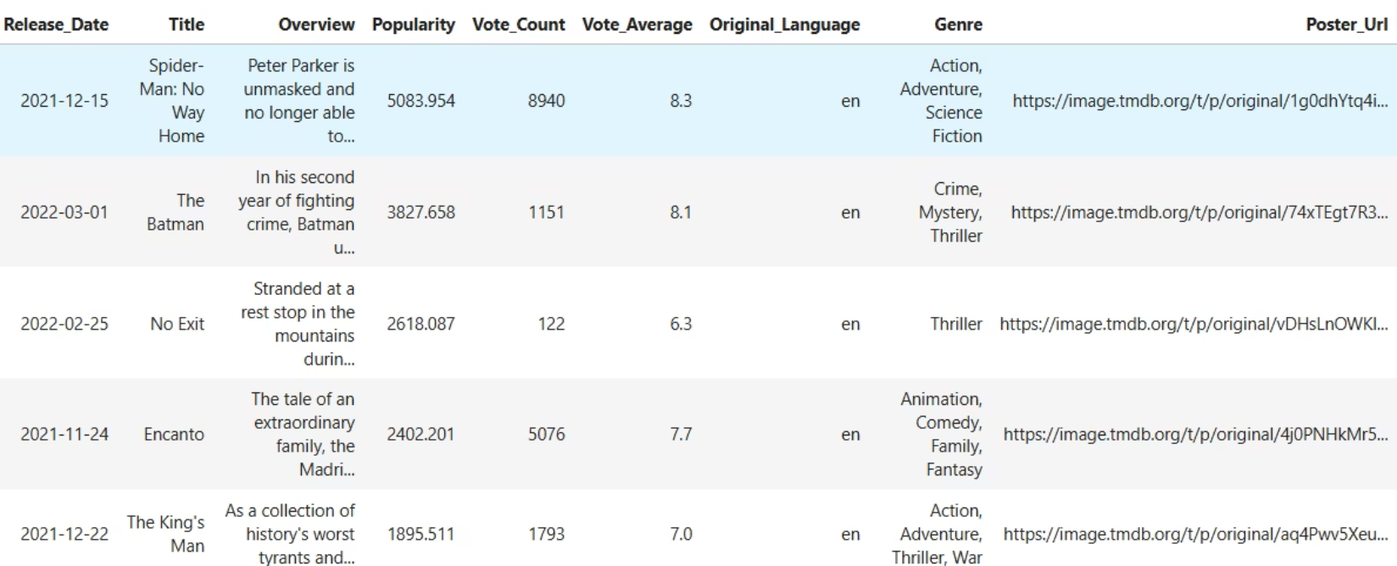
Movie Dataset Details
Attribute-TypeRelease_Date-objectTitle -objectOverview-objectPopularity-float64Vote_Count-int64Vote_Average-float64Original_Language-objectGenre -objectPoster_Url-object

Slide 5
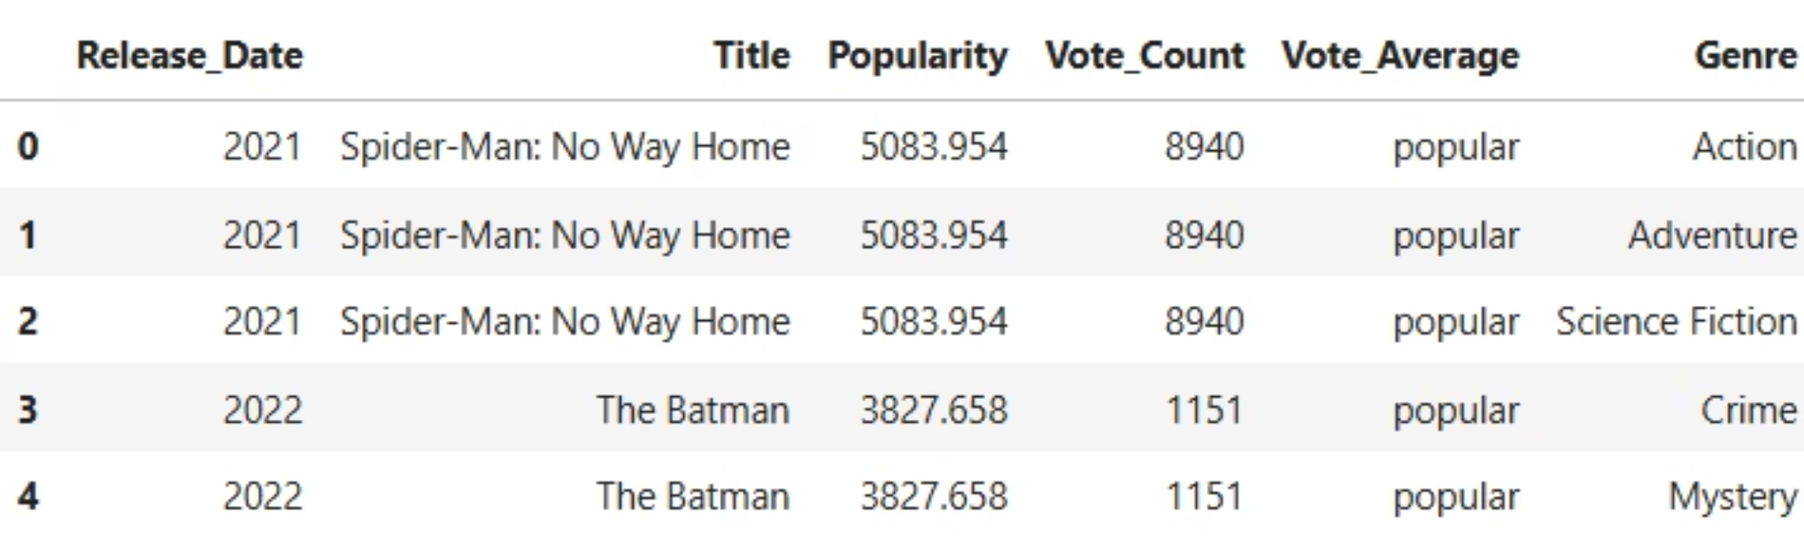
After Cleaning Data
Convert Release_Date from object to time
Remove attributes "Overview", "Original_Language" and "Poster_Url"
Conver Vote_Average from numeric data to categorical data
Split the "Genre" to individual rows

Slide 6


Key Libraries
Pandas:
Pandas is a Python library used for data manipulation and analysis, providing powerful data structures like DataFrame and Series.
Seaborn:
Seaborn is a Python data visualization library based on Matplotlib that provides a high-level interface for creating attractive and informative statistical graphics.
from scipy.stats import linregress:
linregress from scipy.stats performs simple linear regression to find the best-fit line between two variables, returning slope, intercept, and statistical measures.

Slide 7
GIT HUB LINK:-
https://github.com/madhumitha-2004/Netflix_data_analysis

